Slide 1

Realtime tracking of DRS Probe
CS21B1069 – Rahul k

Slide 2
INTRODUCTION
Tumor margin tracing using Diffuse Reflectance Spectroscopy (DRS) probes represents a cutting-edge approach in the realm of oncologic surgery
The integration of DRS probes into the surgical workflow enables surgeons to interrogate tissue composition at the molecular level, facilitating rapid and accurate identification of tumor margins. These probes, equipped with fiber optic sensors, emit light into the tissue and measure the resulting spectral signatures, which are then analyzed to determine tissue composition.
One of the key advantages of DRS-based tumor margin tracing is its ability to provide objective, quantitative data in real time, empowering surgeons to make informed decisions during the surgical procedure

Slide 3
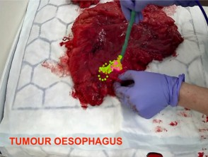
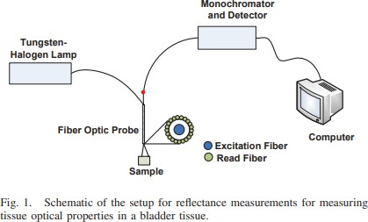

Literature Survey
The aim of surgery is for complete resection of the tumor with clear margins, while preserving as much surrounding healthy tissue as possible.
_{1.} Gkouzionis, I.; Nazarian, S.; Kawka, M.; Darzi, A.; Patel, N.; Peters, C.J. and Elson, D.S.(2022) “Real-time tracking of a diﬀuse reflectance spectroscopy probe used
to aid histological validation of margin assessment in upper gastrointestinal cancer resection surgery.” 27(2) pp.3-5 .
2. Anand, S.; Cicchi, R.; Martelli, F.; Crisci, A.; Nesi, G.; Carini, M.; Pavone, F.S.“Estimation of tissue optical properties between diﬀerent grades and stages of urothelial carcinoma using diﬀuse reflectance spectroscopy”.
2

Slide 4
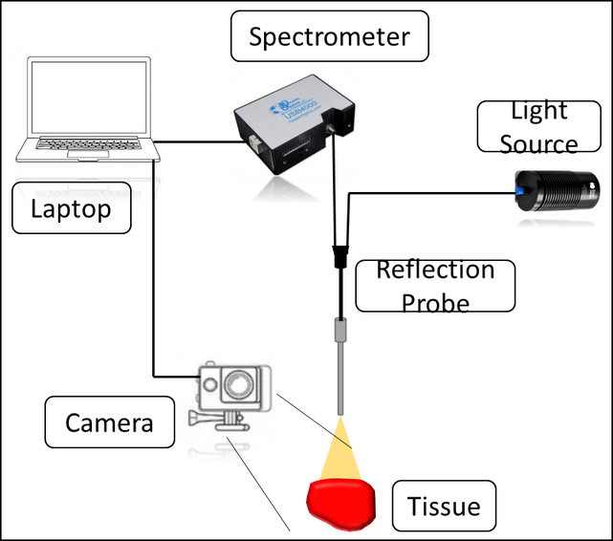
Schematic Diagram
Light Source - https://www.oceaninsight.com/products/light-sources/vis-and-nir-light-sources/hl-2000-hp/ Spectrometer - https://www.photonics.com/
Laptop - https://www.vectorstock.com/royalty-free-vector/continuous-line-drawing-a-modern-laptop-vector-24919986 Camera - https://www.canstockphoto.jp/illustration/gopro.html
3

Slide 5
Tungsten Halogen Light Source Properties
S. No.
1.
2.
3.
4.
5.
6.
7.
8.
9.
Specifications
Wavelength Range Source
Nominal Bulb Power Typical Output Power Color Temperature Drift of Optical Output Source Lifetime
Stability of Light Source Output Warm-up Time
Measurements
360nm - 2.4μm
High-powered Tungsten Halogen 20 W
8.8 mW 3000 K
<0.1% per hour
1000 hours (typical)
0.25% peak-to-peak
10 minutes
Ocean Insight, "Tungsten Halogen Light Source HL-2000-HP"
5

Slide 6
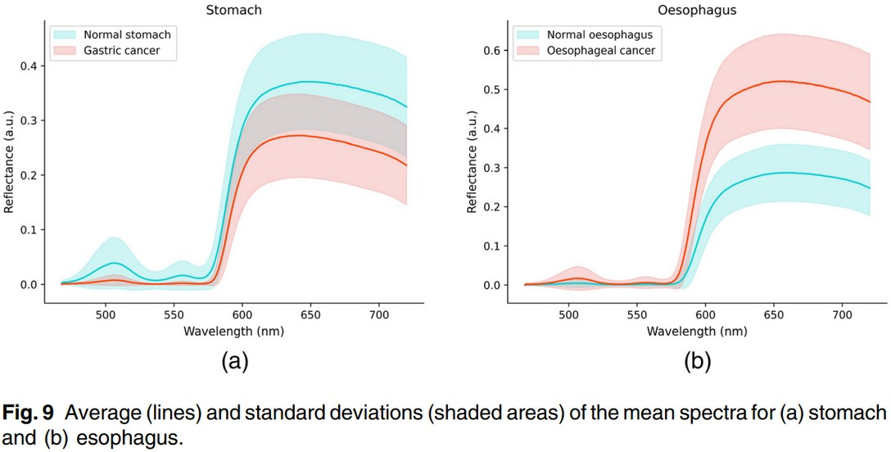
Optical Properties
Gkouzionis, I.; Nazarian, S.; Kawka, M.; Darzi, A.; Patel, N.; Peters, C.J. and Elson, D.S.(2022) “Real-time tracking of a diﬀuse reflectance spectroscopy probe used to aid histological validation of margin assessment in upper gastrointestinal cancer resection surgery.” 27(2) pp.3-5 .
6

Slide 7
SOLUTION
Our setup would require a DRS probe and a webcam to capture the movements of the probe and an algorithm to process the data and classify each tissue as healthy or tumour tissue.
Train your model with data where it can classify the tissue cells.
Design a model/system where data is being sent into data in regular intervals.
Capture and Process the video of The probe to track its movements and use different colors to distinguish between tumor and non tumor cells.

Slide 8
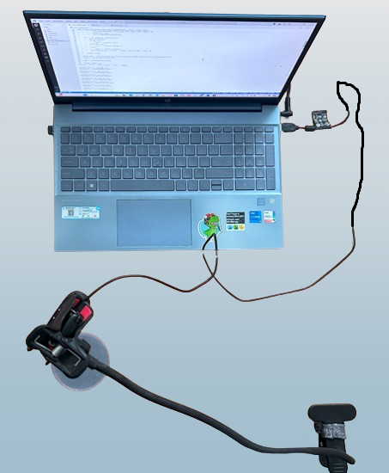
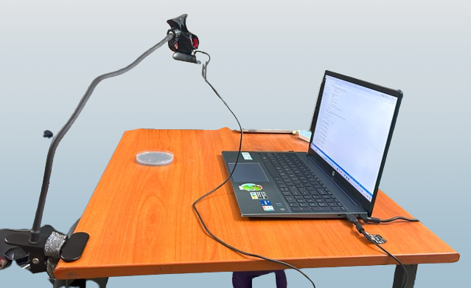
SET-UP

Slide 9
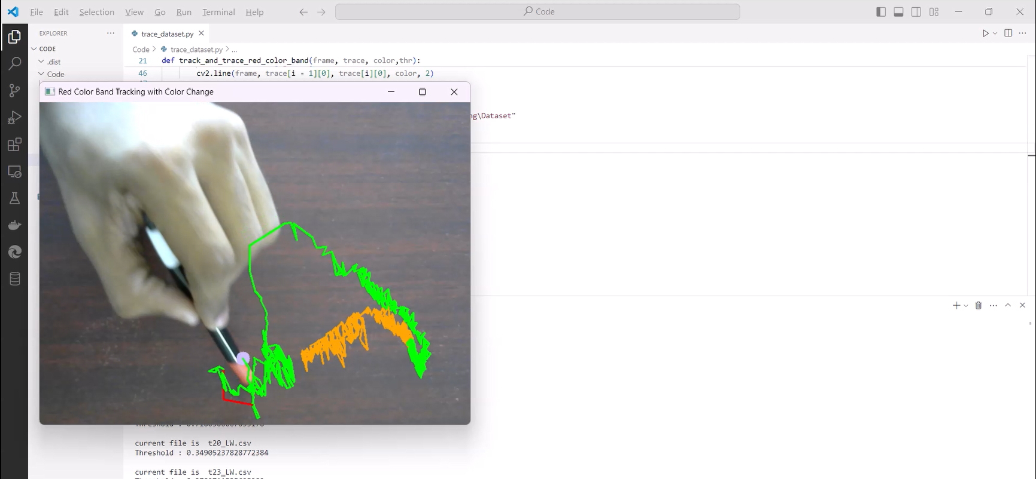
Prototype
9

Slide 10
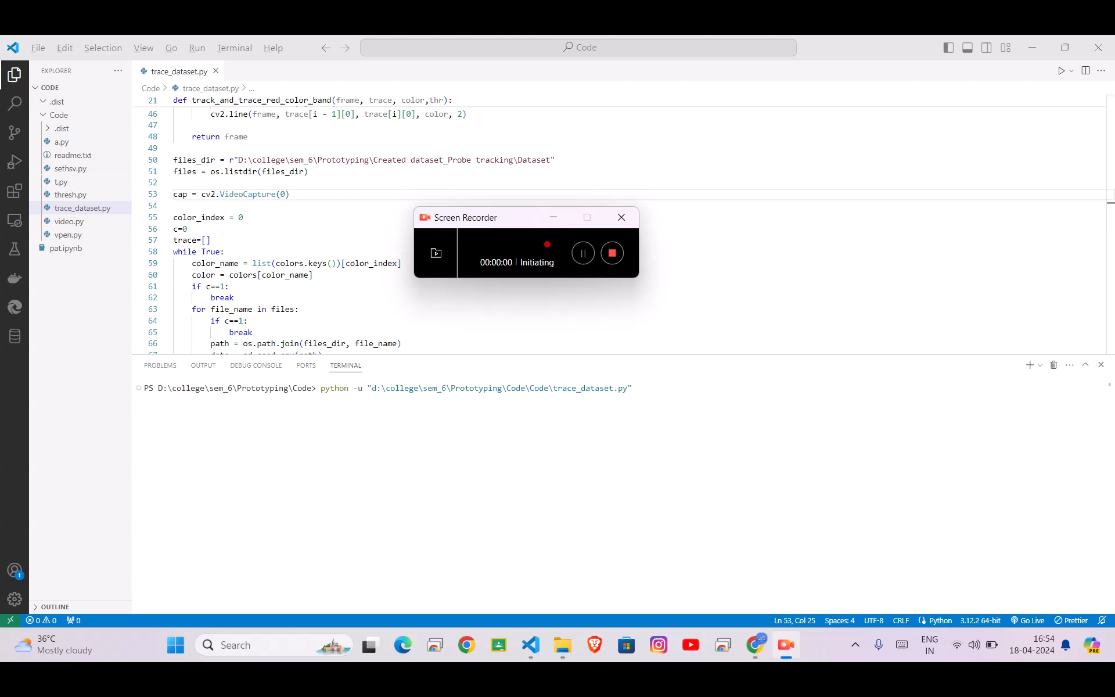
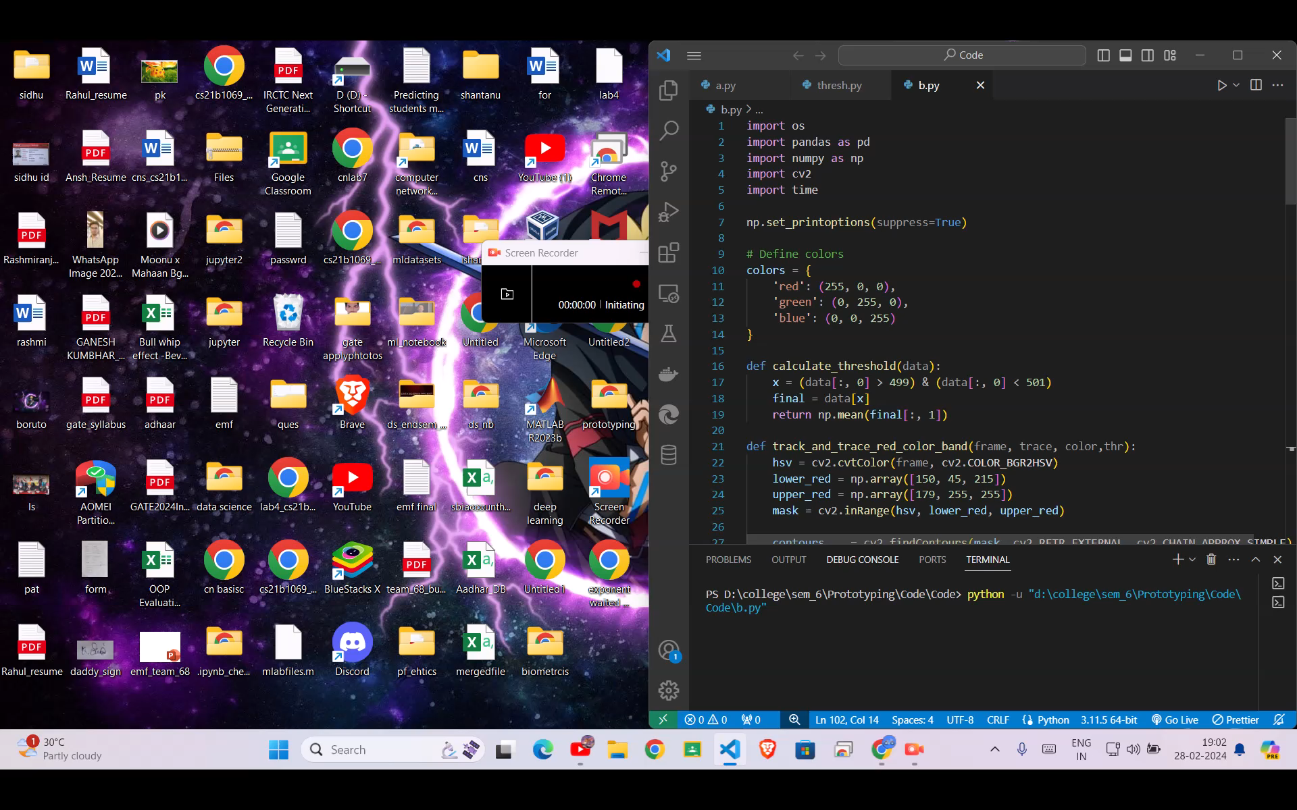
Demonstration
9

Slide 11
References
1.
“Real-time tracking of a diffuse reflectance spectroscopy probe used to aid histological validation of margin assessment in upper gastrointestinal cancer resection surgery.” Ioannis Gkouzionis, Scarlet Nazarian, Michal Kawka, Ara Darzi, Nisha Patel, Christopher J. Peters and Daniel S. Elson . Paper here.
“Assessment of optical localizer accuracy for computer aided surgery systems.” ROBERT ELFRING, MATI AS DE LA FUENTE, & KLAUS RADERMACHER. Paper here.
“Estimation of tissue optical properties between different grades and stages of urothelial carcinoma
using diffuse reflectance spectroscopy”Suresh Anand, Riccardo Cicchi, Fabrizio Martelli, Alfonso Crisci, Gabriella Nesi, Marco Carini and Francesco Saverio Pavone. Paper here.
2.
3.
10

